Slide 1

Class Registration 2025-2026
Rising 11th graders (Current 10th Graders)

Slide 2
The basics
Your form must be filled out completely- do not leave anything blank
Make sure you WRITE YOUR NAME LEGIBLY!!!
PLEASE COMPLETE IN PENCIL!!!
Form must be signed by both student and parent
Make sure to circle your main choices and number off your alternatives (1, 2, 3)
You should be talking with your teachers about their recommendation for your placement next year!

Slide 3
English
Need 4 credits for Graduation!!!
Eng 1/Hon → Eng 2/Hon
Eng 2/Hon → AICE Gen Paper, AP Lang
AICE Gen Paper → AP Lang, Eng 4/Hon, Composition 1/II (Dual Enrollment)
AP Lang→ AP Eng Lit, Comp 2 (if you pass your AP Lang exam with 3+)
  To take Composition 1/2:
    Must have completed English 1 and 2
    Must have a 3.0 unweighted GPA at time of registration (NOW!)
    Must have qualifying PERT/ ACT/ SAT/ PSAT scores by May 1, 2024
    Must have an SPC ID #

Slide 4
Math
Need 4 credits for Graduation!!!
  Including Algebra 1 and Geometry
Algebra 1 → Geometry / Geometry Honors
Geometry/Hon → Algebra 2/Hon, Math College Lib Arts
Algebra 2/Hon → Pre-Calc/AP, Prob and Stats/AP, Int Alg/College Algebra, or Math College Algebra
  To take Int/College Alg:
    Must have an SPC ID #
    Must be in Algebra 2 or higher math right now and doing well
    Must have a 3.0 unweighted GPA at time of registration (NOW!)
    Must have qualifying PERT/ ACT/ SAT/ PSAT scores by May 1, 2024

Slide 5
Science
Need 3 credits for Graduation!!!
  Including Biology
Biology (passing C or higher)- Chemistry or Chemistry Honors, Marine Science or AICE Marine, Anatomy or Anatomy Honors, Physics or Physics Honors
Biology (failing or D)- Environmental Science
AP science courses are your choice to make after you complete Biology

Slide 6
Social Studies
Need 3.5 credits for Graduation!!!
  Including World History (1.0), US History (1.0), Economics (0.5), Government (0.5), Personal Financial Literacy (0.5)
11th grade- US History (Honors or AP US History)
***DON’T FORGET TO TAKE ECONOMICS, GOVERNMENT, and Personal Financial Literacy!!!

Slide 7
Medical Class…
Traditional Track
  Health Science A & P → Allied Health OR LPN
    If you are a 1st year CWMP student, make sure you have doubled up on Health Science Foundations AND Health Science A & P to continue in CWMP program!
Bio Med
  Human Body Systems/Anatomy Honors → Medical Interventions/Genetics
  Principles of Biomed (late entry)→Human Body Systems/Anatomy Honors
Pharmacy:
  Pharmacy 2 and 3 → Pharmacy 4 and 5

Slide 8
electives
Personal Financial Literacy- You can choose to take the honors version too! Put it on your schedule if you have not already taken this year, as it is a graduation requirement.
HOPE (If you have played 2 years for a JV/Varsity sport, ask for Waiver!!!)
Fine Performing Art class (ALL Medical Classes count √)
Foreign Language- minimum of 2 years for University Admission and Bright Futures; Highly recommend 3 or more
If you want to take DE classes at SPC you can put that on schedule for electives—registration for these off-campus classes is in April (deadline last day of school in May)
  Need 3.0 unweighted GPA, qualifying test scores, and SPC ID given to Mrs. Picard!!!
***If you fail the FSA ELA exam you will be placed into Reading for next year

Slide 9
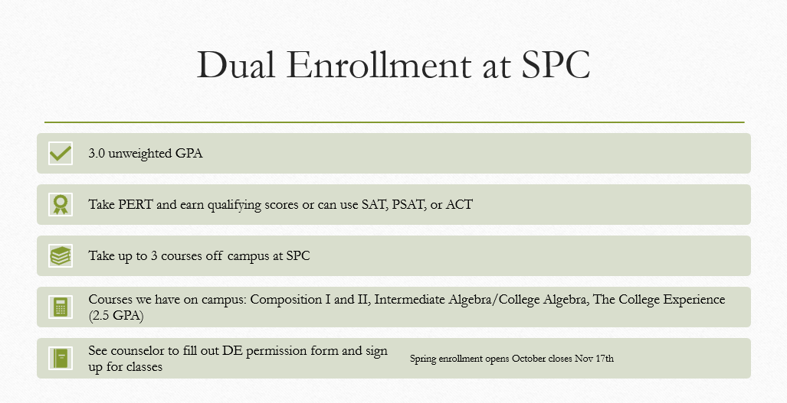
Registration Time Frame: March- May 1st

Slide 10
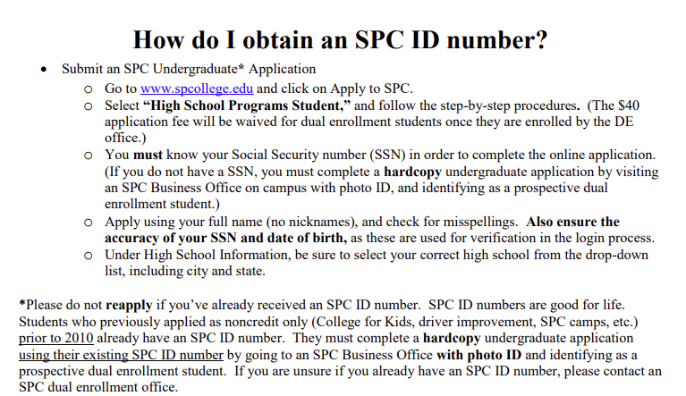

Slide 11
Online classes
Do NOT list online classes on your course request sheet that you want to take with Florida or Pinellas Virtual
You must have 7 periods at PHUHS to start
Online classes will not be adjusted onto your schedule until August
Online Core Classes are strongly discouraged
  (English, Math, Science, Social Studies)

Slide 12
CABAM- business
Business Management & Analysis (Business Communication, Entrepreneurship & Small Business, QuickBooks Online, Design for Delight – Project Management)
          Business & Entrepreneurial Principles (H)(C)
          Legal Aspects of Business (H)
          Accounting Applications I (H)
Computer Science (Many Information Technology Specialist Certifications)
          Foundations of Programming (H)
          AP Computer Science Principles (C)
          AP Computer Science A (C)
Digital Design (Adobe Photoshop, Illustrator, InDesign, & More)
          Digital Design I, II, III & IV (H) (C)
Hospitality & Tourism Management (Business Communication, and Entrepreneurship & Small Business Management, ServSafe, Design for Delight – Project Management)
          Introduction to Hospitality & Tourism (C)
          Technology for Hospitality & Tourism
          Hospitality & Tourism Marketing & Management (H)
          Hospitality & Tourism Internship

Slide 13
CABAM-Business
Entertainment, Recreation & Sports Marketing (Business Communication, and Entrepreneurship & Small Business Management, Social Media Marketing, Design for Delight – Project Management)
          Sports, Recreation & Entertainment Essentials
          Sports, Recreation & Entertainment Applications
          Sports, Recreation & Entertainment Marketing & Management (H)
          Sports, Recreation & Entertainment Internship
Television Production (Adobe - Premiere Pro & More, Business Communication, Social Media Marketing, Design for Delight – Project Management)
          Digital Media Technology 1-4
Also available:
Digital Information Technology (C) (Recommended for all program participants)
Personal Financial Literacy (H) (1 Semester)
Business Education Directed Study (For Junior & Senior Program Completers only)
Key:
(H): Honors Level Course – Students earn additional points in their GPA
(C): College Credit – Can be earned through SPC with grade of A or B

Slide 14
Submitting forms
Completed forms are DUE to your medical teacher or CWMP OFFICE on Monday!
Make sure to circle your main choices and number off your alternatives (1, 2, 3)
PLEASE COMPLETE THE FORM IN PENCIL
Be sure you get parent signature on back!
Mrs. Picard will review the forms after submission and enter requests into FOCUS
Mrs. Picard can and will make any needed adjustments to your registration form if it is completed incorrectly and can change a course request up until the last day of school
If you do not submit a form, you will receive a counselor generated schedule for next year
Students can schedule an appointment with Mrs. Picard up in the CWMP Office if there are any concerns w/classes. -See Mrs. Marino for process!

Slide 15

Xello Activity
Form passed out
Follow Directions

